Slide 1

NextHikes IT Solutions Bike Sharing Demand Analysis Project 1
By Sanjeev Kr. Singh

Slide 2


Introduction
•“During my internship at Nextgen Hike Solutions, I worked on a project involving three datasets.
•The main goal was to clean, merge, analyze, and visualize the data to generate meaningful insights.
•I’ll walk you through the steps I took.”

Slide 3

Project Objective
The purpose of this project was:
To combine multiple datasets into a single structured file
Perform data cleaning and handle missing values
Apply advanced Excel functions for analysis
Generate insights and create an automated reporting template.

Slide 4
Tools & Techniques Used
Excel Features Used:
Power Query (for merging datasets)
Conditional Logic (IF statements)
Lookup Functions (VLOOKUP, INDEX-MATCH)
Pivot Tables & Charts
Statistical Functions (SUMIF, COUNTIF, STDEV, CORREL)
Data Visualization
Automation (Macros / Template Design)

Slide 5
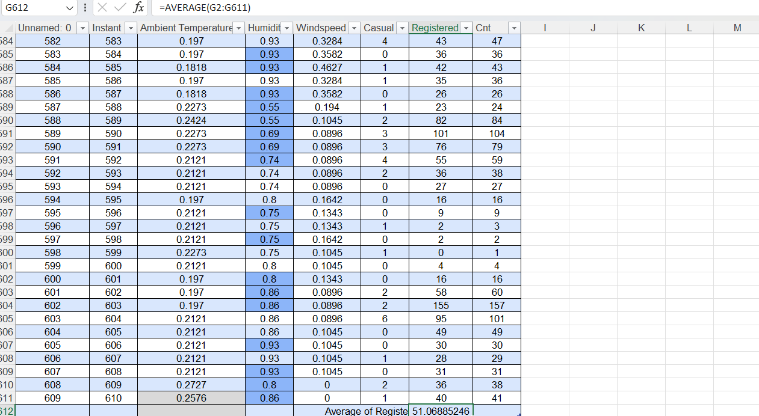
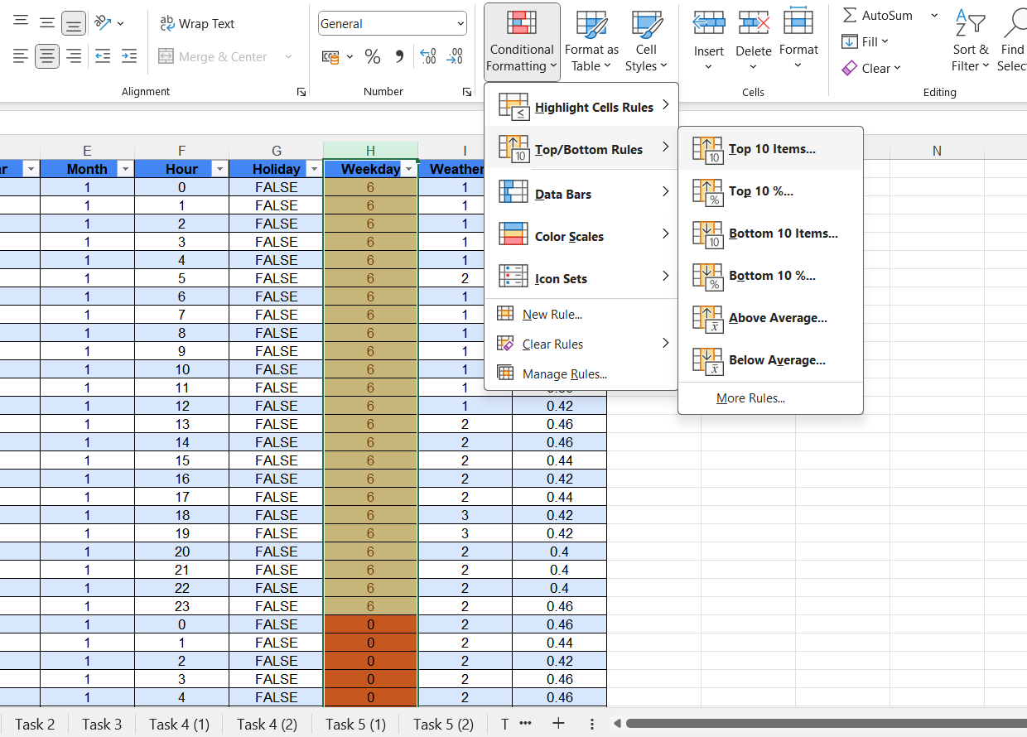
Task 1. Excel Foundations & Data Handling
The first step was to strengthen the basics
Navigated Excel interface and used shortcuts
Entered, sorted, and filtered data
Used basic formulas like SUM, AVERAGE, COUNT
Worked with TEXT functions: LEFT, RIGHT, LEN
Applied conditional formatting to highlight important values.
In the first task, I prepared the dataset by applying proper formatting to make it more readable and structured. I formatted date columns, adjusted column sizes, and applied borders and bold headers. Next, I organized the data using sorting and filtering, which helped in analyzing specific conditions like weekends or weather patterns. Finally, I used basic Excel functions like SUM to calculate total rides, AVERAGE for daily averages, and COUNT to check the number of records in the dataset. This provided the foundation for the next steps in analysis.

Slide 6
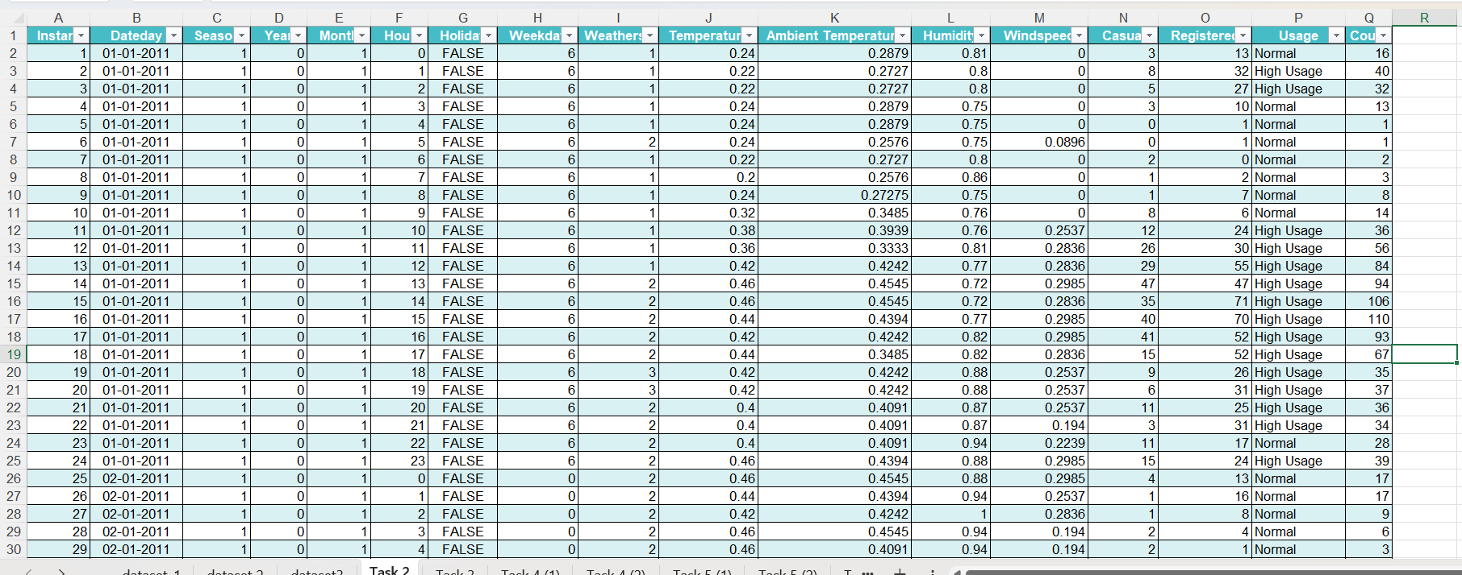
Task 2. Data Loading, Merging & Cleaning
Power Query for efficient merging
VLOOKUP and INDEX-MATCH for linking related fields
Ensured proper data types and removed duplicates.
In this step, I imported all three datasets into Excel and merged them using common keys like Instant, DateDay, and Hour. For merging, I used Power Query and also applied VLOOKUP and INDEX-MATCH formulas. After merging, I cleaned the data by removing duplicates, correcting data types, and handling missing or inconsistent values by using =Median(number1,number2…).

Slide 7
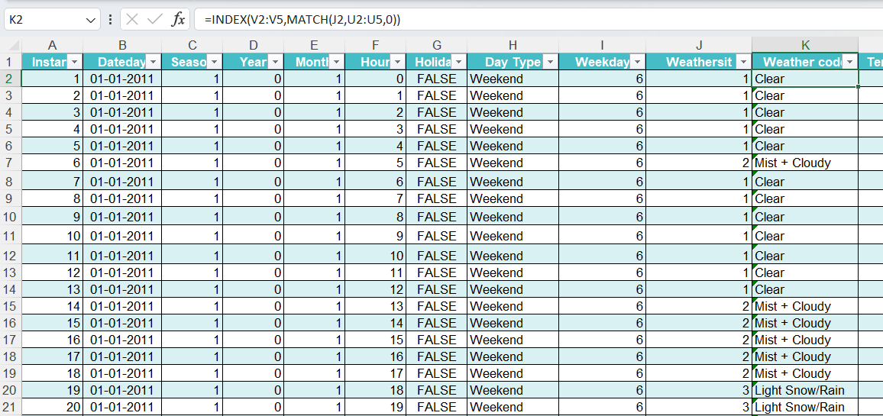
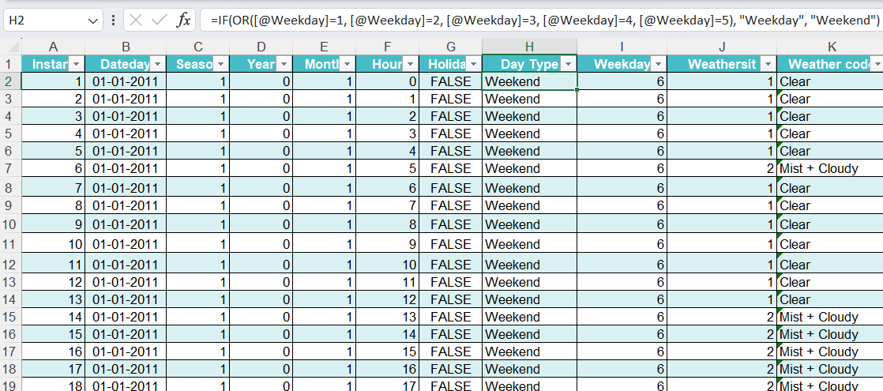
Task 3. Conditional Logic & Lookup Functions
Used IF statements to classify:
=IF(OR(Weekday="Saturday", Weekday="Sunday"),"Weekend","Weekday")
Applied nested IF for multiple conditions
Implemented VLOOKUP to fetch related values from another table:
Example: Match weather code with its description
Used INDEX-MATCH as an alternative to VLOOKUP for flexibility
I used IF and nested IF statements to classify days as weekdays or weekends.
Additionally, I used VLOOKUP to fetch related data, such as mapping weather codes to weather descriptions. In some cases, I used INDEX-MATCH for more accurate lookups when column positions were an issue.

Slide 8
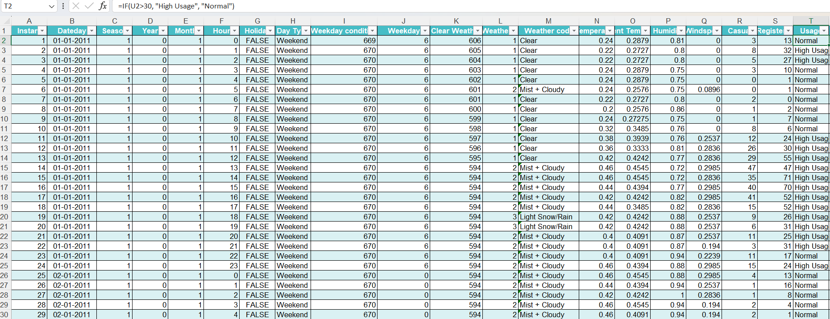
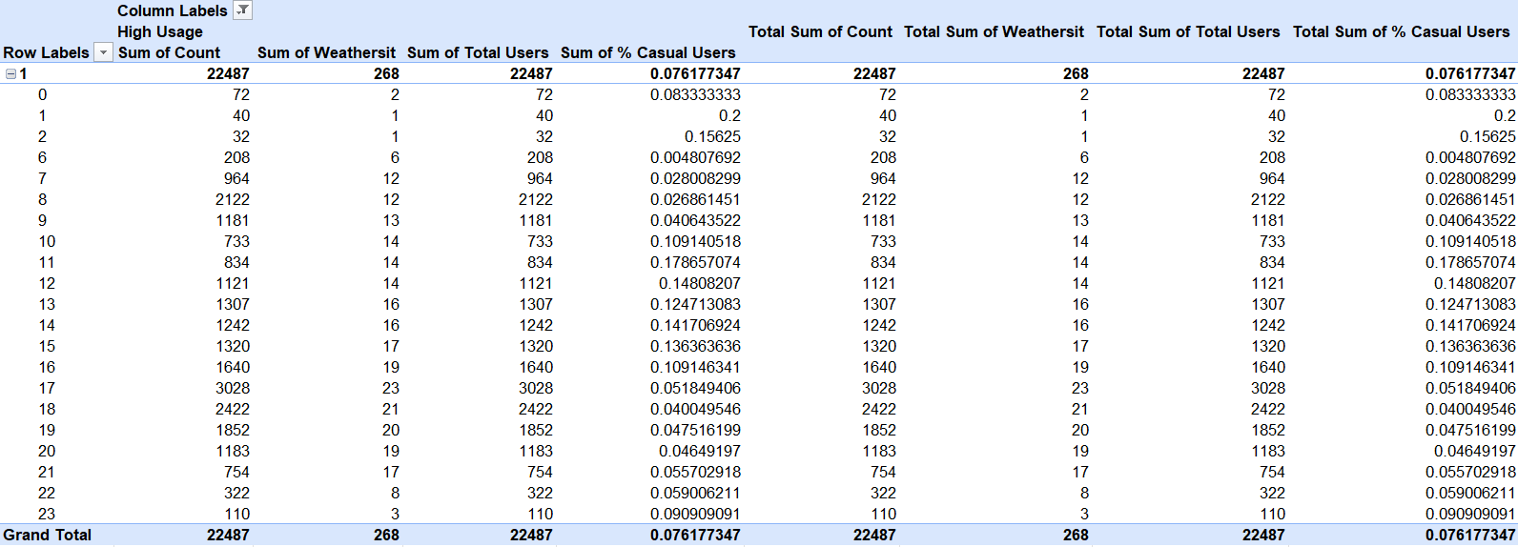
Task 4. Advanced Data Analysis
Created Pivot Tables to analyze:
Hourly demand trends
Weather-wise usage
User type comparison (casual vs registered)
Used Pivot Charts for visual summaries
Applied statistical formulas:
COUNTIF() – Count rides on holidays/weekends
SUMIF() – Total rides by season or weather
STDEV() – Demand variation across time
CORREL() – Correlation between temperature & ride demand
I used Pivot Tables and Charts to analyze demand by hour, weather, and user type, and applied COUNTIF, SUMIF, STDEV, and CORREL to uncover trends, seasonal effects, and demand variations.
This helped identify trends, seasonal effects, and demand fluctuations.

Slide 9
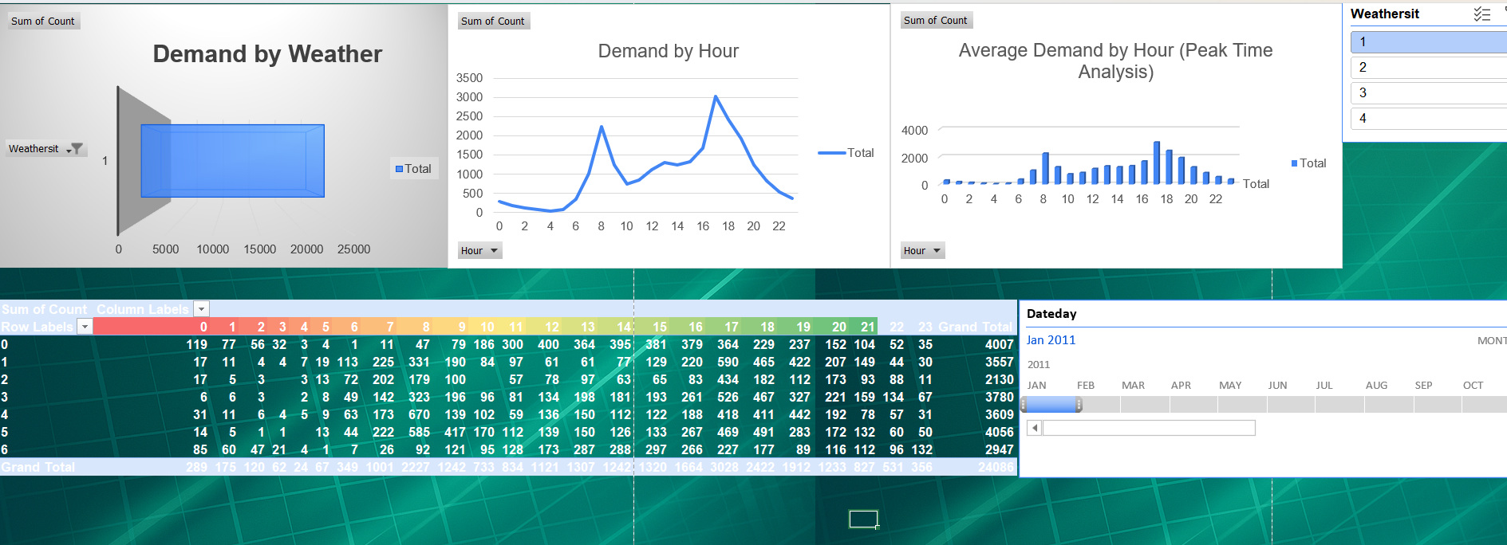
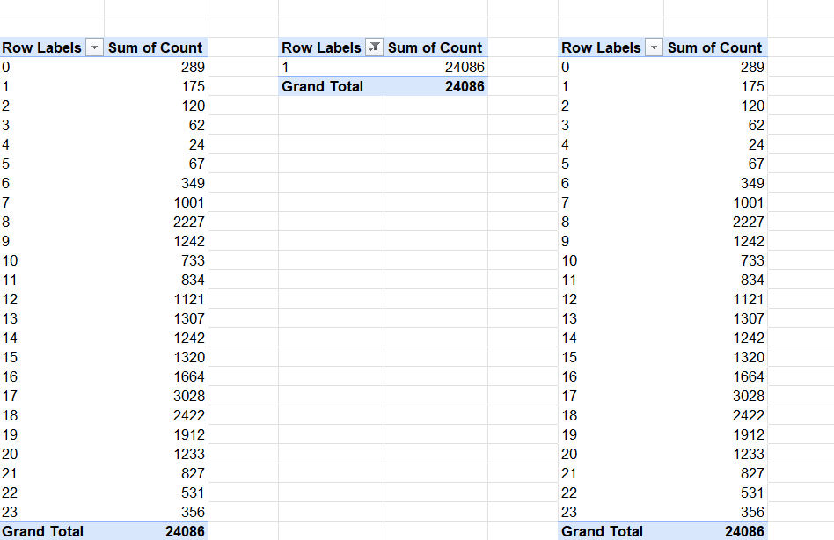
Task 5. Data Visualization & Business Intelligence
Created charts to show:
Demand trends by hour, day, and season
Impact of weather conditions on rides
Used line charts for time-based trends
Used bar and column charts for category comparisons
Applied conditional formatting to:
Highlight peak demand hours
Identify low-demand periods
Color-code weather impact
This dashboard shows ride demand trends with charts for weather impact, hourly demand, and peak time analysis. The pivot table summarizes rides by hour, and slicers allow quick filtering by weather and date for interactive insights.
I applied conditional formatting in the dataset to highlight key insights, such as peak demand hours and low-demand periods, using color coding for quick interpretation.

Slide 10
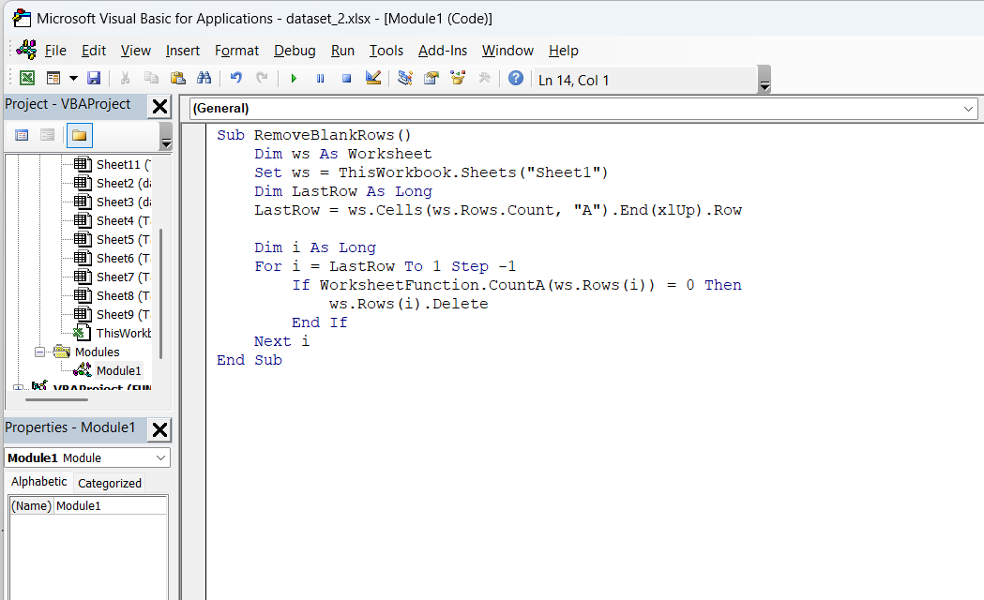
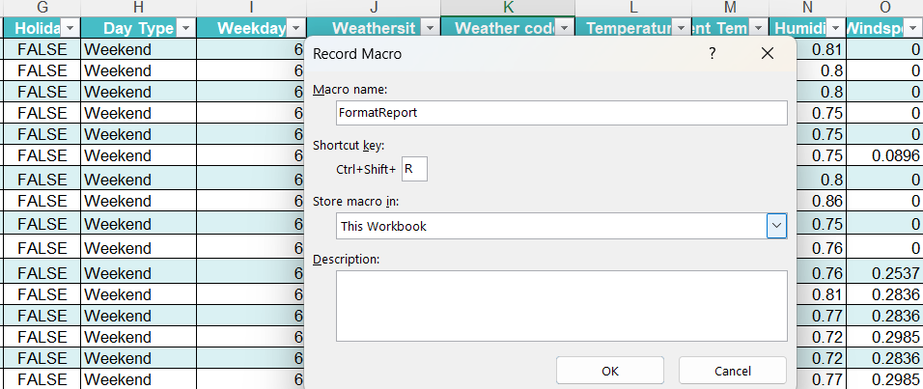
Task 6. Automation with VBA & AI Macros
Recorded Excel Macros to automate repetitive tasks
Wrote VBA scripts for:
Data cleaning (remove blanks, format columns)
Conditional logic for reporting
Used loops & conditionals for batch processing
Created custom functions (UDFs) in VBA
Integrated AI-powered features for:
Predictive analysis
Automated report generation
In this step, I automated several tasks using Excel macros and VBA. I started by recording macros for repetitive operations like formatting and applying formulas. Then, I wrote VBA scripts with loops and conditionals to automate data cleaning and reporting processes.
I also created custom functions in VBA to simplify complex calculations.

Slide 11
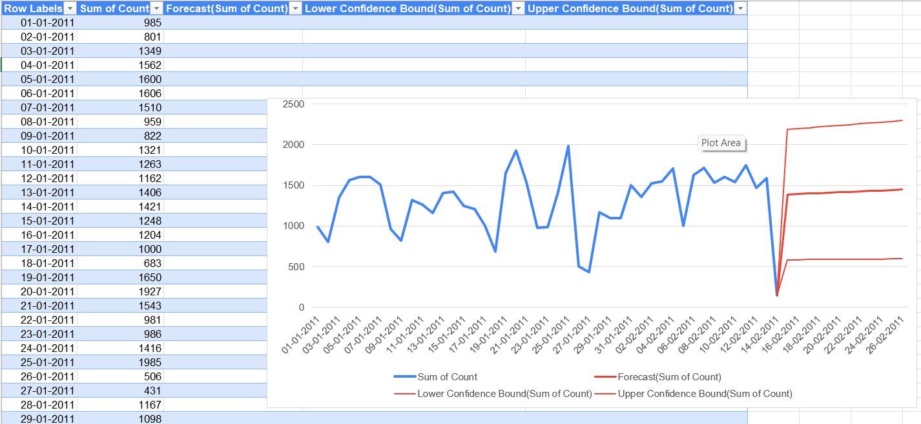
Task 7 – Automated Data Reporting
Combined all previous skills for end-to-end automation
Automated data cleaning & transformation for new imports
Integrated forecasting & anomaly detection into reports
Designed interactive dashboards with auto-updating charts and Pivot Tables
Enabled one-click reporting using macros
In this final task, I combined everything from the previous tasks to build an automated reporting system. This included automatically cleaning new data as soon as it was imported, running AI-powered forecasting to predict future demand, and applying anomaly detection to highlight unusual patterns.
I then created an interactive dashboard that updates automatically whenever new data is added. To make reporting simple, I used macros to generate the full report with a single click, saving time and reducing manual effort.

Slide 12
Detailed Explanation: Peak Hours: Analysis showed demand is highest during morning (8–9 AM) and evening (5–6 PM) rush hours. Weather Impact: Fewer rides during rainy or bad weather, more rides in clear conditions. Correlation Findings: Positive correlation between temperature and ride demand – warmer days saw more rides.
Key Insights & Observations
Peak hours identified
Weather impact on demand
Correlation findings

Slide 13
Detailed Explanation: Merging Datasets: Aligning three different datasets with different structures required VLOOKUP and INDEX-MATCH. Handling Missing Values: Some columns had blanks or inconsistent data, which affected calculations. Automation Complexity: Writing macros and VBA code for multiple steps was challenging initially.
Challenges Faced
Solutions Implemented
Merging datasets
Handling missing values
Automation complexity
Lookup functions
Conditional logic
Automation setup
Detailed Explanation:
Lookup Functions: Used VLOOKUP and INDEX-MATCH for merging data accurately.
Conditional Logic: Applied IF statements for classification (e.g., weekdays vs weekends).
Automation: Built macros and VBA scripts to clean data and generate reports automatically.

Slide 14
Final Outcome & Business Impact
Clean, structured data
Quick analysis and reporting
Improved decision-making
Detailed Explanation: Clean Data: Removed duplicates, formatted columns, and fixed missing values. Quick Analysis: Automated dashboards and Pivot Tables reduced manual effort. Business Impact: Faster reporting enabled timely and accurate decision-making.
Thank you
Contact Details: 📧 Email: sanjeevkumarsingh724@gmail.com 📞 Phone: +91-6205218040

